Slide 1
FUNCTIONALISM
Durkheim
Social cement
Rituals, ceremonies and beliefs
‘Collective conscience’
Symbols

Slide 2
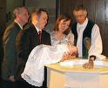
Why would Durkheim see these rituals as creating unity in the social group?

Slide 3
Malinowski
Religion as a response to anxiety/tension
Helps to deal with life crises
Re-integrates social group
Religious ritual associated with threats to survival

Slide 4
PARSONS
Generates social solidarity and stability
Answers to big questions
Core values backed up by reference to higher power
Legitimises norms and values
Maintains consensus

Slide 5
BELLAH
In a multi-faith society a ‘civil religion’ develops
People bound together by faith in their nationality
‘God Bless America’

Slide 6
MARXISM
Religion fulfils functions for the ruling class
Ideology
Social control
Keeps subordinate classes in their place
Keeps the workers in ‘false class consciousness’
Justifies social inequality
Ideological conditioning device

Slide 7
The Opium of the people………
‘Opiate of the masses’ to deal with alienation
Mystification
Legitimising inequality
Church and state closely tied

Slide 8
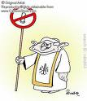
examples
Church of England = the ‘Tory party at prayer’
Catholic church and barrier to social change in developing countries
USA rightwing associated with fundamentalism
Catholic church in Poland overthrew communism
Taliban

Slide 9
criticisms
Secularisation
Liberation theology
‘false class consciousness’ cannot be falsified
Neo-Marxists and religion as a vehicle for social change and ‘class consciousness’

Slide 10
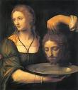
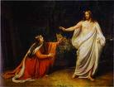
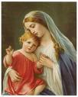
FEMINISM
Eve
Salome
Delilah
Mary Magdalene
Virgin Mary

Slide 11
Freedom or oppression?
‘Tell the faithful women to lower their gaze and guard their private parts and not display their beauty except what is apparent of it, and to extend their scarf to cover their bosom’
Koran, 24:31

Slide 12
POSTMODERNISM
No ‘meta-narratives’
Moral relativity
No certainty
Spiritual shopping
Consumerism
Multi-culturalism
Globalisation and ‘shrinking world’
The religious market
The privatisation of religion

